Slide 1

Business Idea Presentation
Home Meal Replacement Integration Platform
Lee Sung HO(이성호) 16102284

Slide 2
- Contents
 - Ⅰ. Business model
 - Ⅱ. Competitive advantage
 - Ⅲ. Marketing Plan
 - Ⅳ. Reference

Slide 3
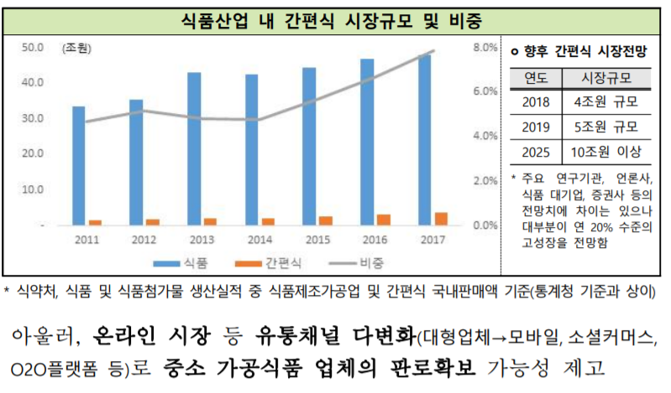
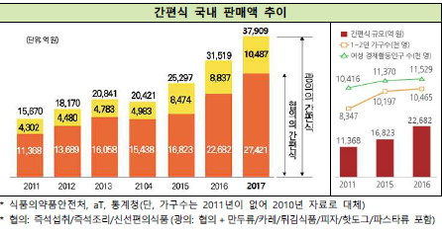
Business Model
The “Home Cooking Culture" is changing as the corona has been around the world for a long time. As people refrain from eating out because of the corona, demand for high-quality foods is increasing, and interest in “Meal-Kit” sales and sales are rapidly increasing.
The ratio of single-person households and women entering the workforce has increased 63 percent over the past three years. In particular, it is estimated that the domestic food market will continue to rise in 2022, which is expected to reach 5 trillion won, up 40 percent from the current level.
※ The report on the status of the processed food sub-market, released by the Korea Agro-Food Distribution Corporation (aT)

Slide 4
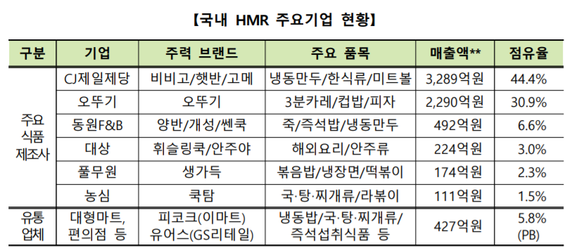
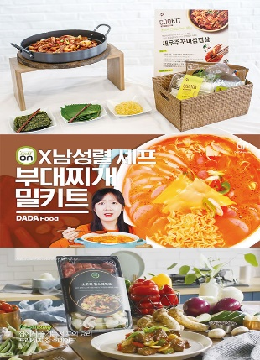
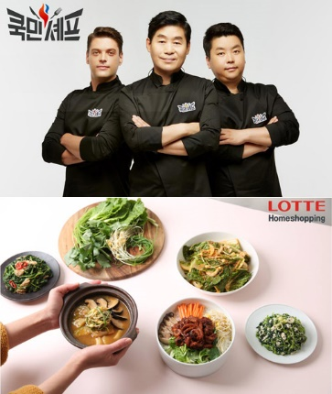
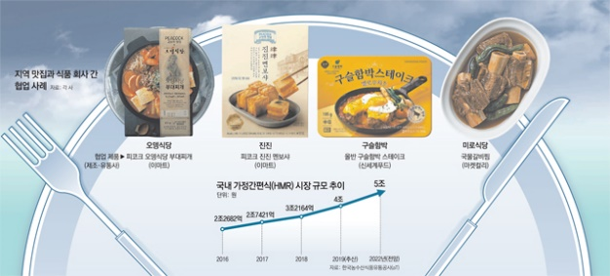
Business Model
In line with this trend, many big companies have entered the market.
According to Home Plus Online Mall, the number of daily products cooked and delivered directly from stores increased 52 percent from February to April last year
월계 E-Mart is operating a Meal-Kit zone where the display stand reaches 13m, and is gradually applied to other branches.
Lotte Mart's side dish brand “반찬하다" increased by 218 percent from last year.
Many large companies plan collaboration products with star chefs or launch popular offline menus.
And They also use their home shopping channel to introduce famous chefs to their products and to promote their recipes.

Slide 5
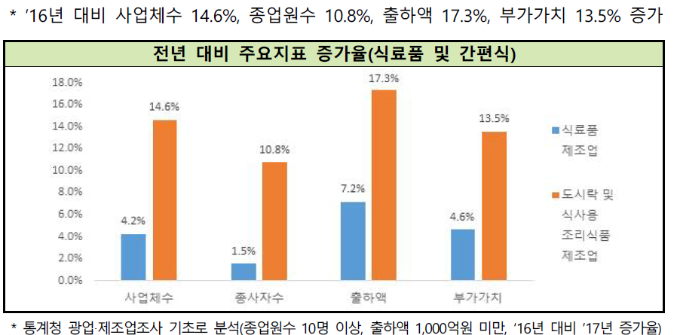
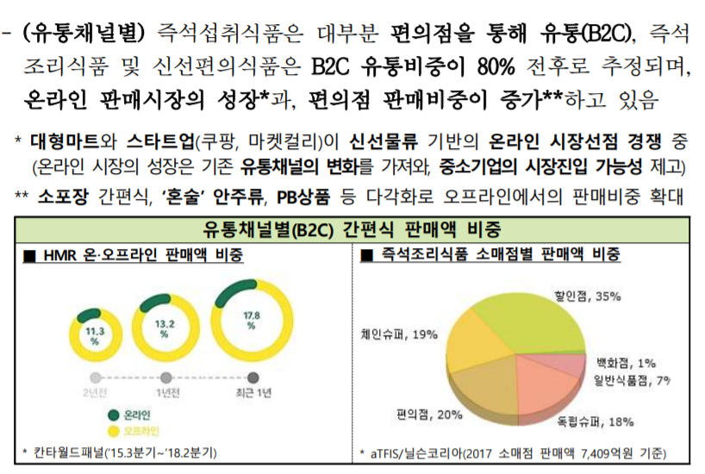
Business Model
However, it was analyzed that many small and medium-sized companies specializing in “Home convenience food kit" contributed greatly to the expansion of market participation and industrial growth.
This is because the online food market, including the competition for fresh delivery, is expanding and online purchases are increasing.
In addition, it is expected that product categories will be diversified and all foods (including traditional processed foods and raw materials) will be simplified in the future, and traditional food companies will advance into the simplified market and be more positive about small and medium food manufacturers.
※ The report on the status of the processed food sub-market, released by the Korea Agro-Food Distribution Corporation (aT)

Slide 6
Business Model
Characteristic of “Meal-Kit Market”
Sensitive to changes in consumer preferences, new product development capabilities are important due to increased competition by item
Expand opportunities for small and medium-sized enterprises to participate in the market due to changes in distribution channels, such as the growth
Prospects to expand overseas markets due to the globalization of food culture, the development of food storage and logistics technologies
Therefore, considering the market characteristics of many companies, which are highly competitive by item, and the market atmosphere in which many companies enter the market to develop blue ocean, we are planning to create a “Platform Service” that enables people to collect and show these materials and to link them so that they can purchase them online or offline, and to share product reviews.

Slide 7
Home convenience food kit companies to commission advertising
Local store owners who want to run a meal-kit business. (if site launched Meal-kit industry)
Delivery service providers (if site launched Meal-kit industry)
Collect all data from the Meal-kit
It provides excellent information for the inflow of users.
An algorithm capable of analyzing and recommending user preferences is created.
It's running well so that it can continue to receive advertisements from advertisers.
First of all, there is no platform site where you can see the all collection of Home convenience food kit. Companies run their own home pages to sell products, or they sell their products through contracts with huge E-commerce such as ‘쿠팡’ and ‘옥션’. This allows consumers to easily and strategically compare the same Meal-kit items as on other platform sites when they gather registered information.
And if consumers come together and create communities like this, it's going to be a channel that businesses can promote.
Moreover we can run meal-kit company using our site’s fame
1. Personalized Recommendation System: If you subscribe regularly, "What should I eat today? We will analyze your purchasing patterns and recommend products that suit your taste and TPO so that you don't fall into the agony of ". 2. Package discount event: We plan to sell products from various companies, including a specific theme (Fri. Party Bundle, Alone Bundle, Camping Bundle), at a discount. 3. Coupon event: We will negotiate with the "home snack" company on our application and offer coupons to buy goods cheaply. 4. Information provided: We will operate a community with information such as services that describe what products were on TV, YouTubers, SNS, etc., reviews of how they are cooked, videos of how they are cooked, and "kick" to be more delicious.
A dual-income couple (mainly used group)
Single tribe (mainly used group)
Advertisers who want to use the channel
Local store owners who want to run a meal-kit business. (if site launched Meal-kit industry)
Data to Know Consumption Trends
A pioneer identity in this field
Online Infra-structure
Platform management, contact with advertisers, and other necessary human resources
Web / Mobile homepage
Delivery products (if site launched Meal-Kit industry)
Server Operating Costs
Wages of employees required, such as platform management, contact with advertisers, etc.
Initial capital required before revenue such as advertising is generated.
Free for Basic Users
Advertisements (exposing specific products first)
User data (what kind of products do consumers primarily use, what kind of product do they review)?
Product brokering fee (if the site grows large)
Sales fees (if the site is big enough to make a profit by selling products directly with local gourmet restaurants and famous chefs)

Slide 8
Competitive advantage of service
There is no competitor who presents the products in a comprehensive way.
Since the market is blue ocean, there is a high possibility of further growth.
Platform services have the advantage of being used by many people due to the market characteristics of consumers who are sensitive to characteristics such as price, quality and convenience.
Users are relatively information-sensitive and familiar with IT devices, so they are familiar with services.
Review data, consumption data, etc., produced by the user are processed and analyzed to obtain the result.

Slide 9
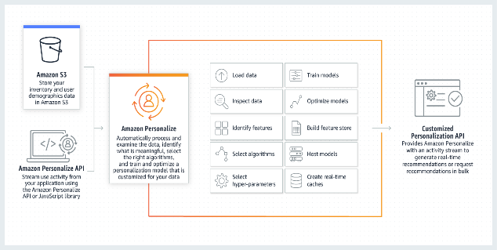
Marketing Plan
Real-time optimization
Using Amazon Personalize, one of Amazon's machine learning technologies, it will analyze consumer preferences and recommend products that suit the TPO situations.
Analyze user reviews in real time, introduce a machine learning technique that prevents recommendations for products similar to the product, and recommend products that consumers really want.
Marketing with Data
It will attract people through promotion using promotional comments like ‘the lowest price!‘
It allows users to spread review data created in the app to a variety of communities, including “NAVER” and “Google,” increasing the influx of new users.

Slide 10
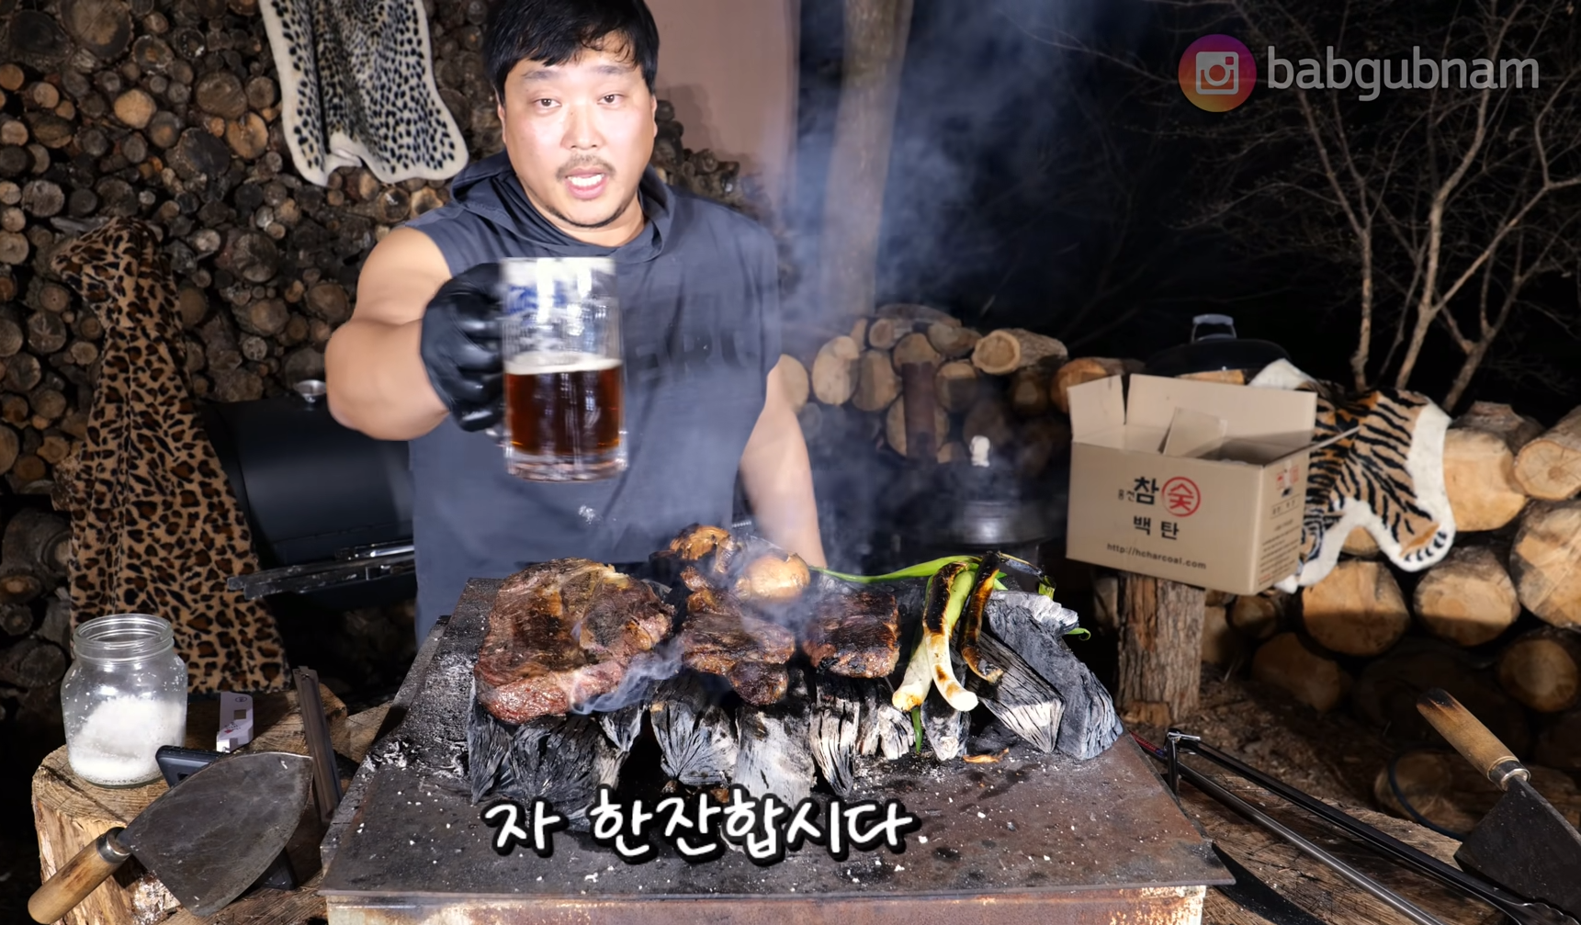
Marketing Plan
Targeting revisiting and dormant users
We will hold a Re-targeting and Re-ingaugement event that provides push notifications and coupon events such as discount events of products that customers have purchased frequently, news of launching similar new products,
We will increase the reuse rate by sending a customized alarm considering TPO, such as sending ‘칼국수’ cooking box prompt alarm at rainny day, or ‘혼술 패키지＇at Friday, or Barbecue package at camping and vacation seasons
A tie-up with a user
Because of the Meal-kit's short-term expiration date, consumers and producers can both win-win marketing by collecting unsold products at discount prices, such as the deadline of department stores' food courts.

Slide 11
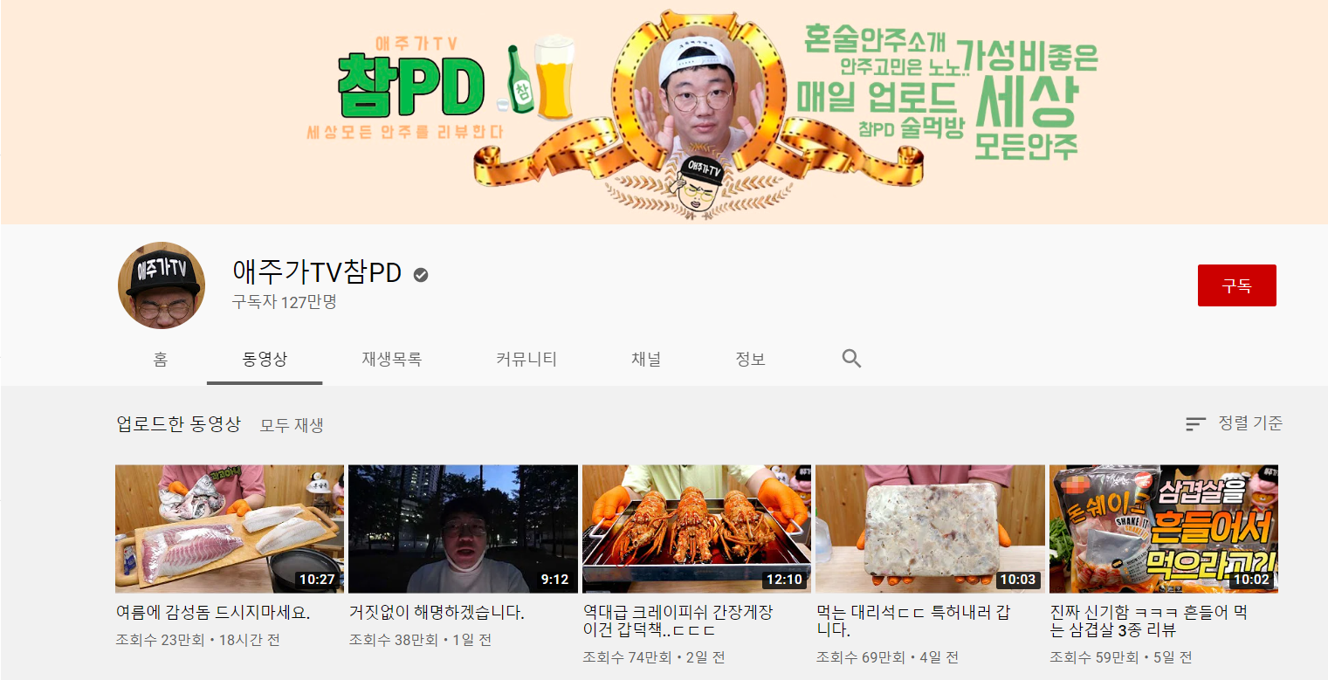
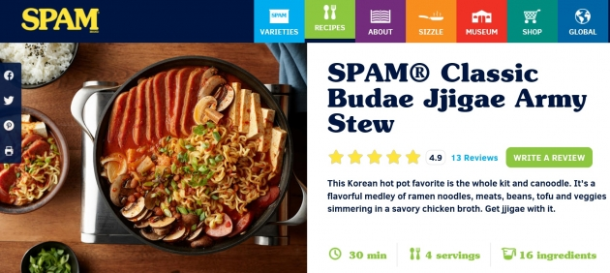
Marketing Plan
SNS & Internet Marketing
Recently, many influencers and YouTubers, do a lot of review content about new products. We will have a public relations event to promote small and medium-sized companies through YouTuber ‘애주가 참PD’, which reviews and promotes free products from small and medium-sized companies, and increase the influx of users.
As the world became Internet-based and Korean culture was introduced, interest in and recognition of Korean food increased as shown in the next picture. Before that, we will promote counteractivities marketing to support the k-food meal-kit to be sold all over the world, as described in the report.

Slide 12
Ⅳ. Reference
https://atfis.or.kr/article/M001080000/view.do?articleId=3255&boardId=18&page=1&searchKey=&searchString=&searchCategory=
https://blog.naver.com/hi_nso/221887052995
https://www.ppomppu.co.kr/zboard/view.php?id=news_pol_eco&no=90290
https://applift.com/blog/app-based-business-technology-mobile-marketing-2
https://www.youtube.com/watch?v=LPAEpWtm9oQ
https://www.youtube.com/user/youl2007
https://www.hankyung.com/economy/article/202003301355i
Designed by: The Business Model Foundry (www.businessmodelgeneration.com/canvas).
PowerPoint implementation by: Neos Chronos Limited (https://neoschronos.com). License: CC BY-SA 3.0

Slide 13
Thank you

